Slide 1
Distributed Systems

Slide 2
A Distributed system is a collection of independent computers that appear to the users of the system as a single computer.

Slide 3
Advantages of Distributed systems over Centralized systems

Slide 4
Disadvantages of DS

Slide 5
Hardware Concepts

Slide 8
Design Issues - Transparency

Slide 9
Design Issues - Flexibility
The Microkernel approach provides four basic services:
An inter-process communication mechanism
Some memory management
A small amount of low-level process management and scheduling
Low-level input/output
It does not provide file system, directory system, full process management and system call handling.

Slide 10
Design Issues - Reliability
Distributed system needs to be more reliable than single processor systems. That is, if a machine goes down, some other machine takes over the job. Example – There are 4 file servers each with 0.95 chance of being up at any instant, the probability of all four being down simultaneously is (0.05)⁴ = 0.000006. Therefore the probability of at least one being available is 0.999994.
Aspects:
Availability – The fraction of time the system is usable.
Availability can be enhanced by a design that does not require the simultaneous functioning of a substantial number of critical components.
Availability can also be improved by Redundancy, where key pieces of hardware and software should be replicated.
However, a highly reliable system should be highly available, but that is not enough.
Security
Fault Tolerance

Slide 11
Design Issues - Performance
Design issues are subject to the system, some common ones are:
Response time
Throughput (Number of jobs per hour)
System utilization
Amount of network capacity consumed
Design Issues - Scalability

Slide 12
Synchronization in Distributed Systems

Slide 13
Clock Synchronization
Synchronization in Distributed systems is more complicated as they use distributed algorithms that have the following properties:
The relevant information is scattered among multiple machines.
Processes make decisions based only on local information.
A single point of failure in the system should be avoided.
No common clock or other precise global time source exists.

Slide 14
Logical Clock
Nearly all computers have a circuit for keeping track of time, ‘Time’ is a more suitable word than ‘Clock’.
A computer timer is usually a precise machined quartz crystal. When kept under tension, they oscillate at well-defined frequency that depends on the kind of crystal, how it is cut and the amount of tension.
Each crystal has two registers associated with them:
Counter and
Holding register.
Clock skew – The difference in time values of different crystals.

Slide 15
Logical Clock
To synchronize logical clocks, Lamport defines a ‘Happens-before’ relation. The expression, a-> b is read ‘a happens before b’.
This can be observed directly in two situations:
If a and b are events in the same process and a occurs before b.
If a is the event of a message being sent by one process, and b is the event of the message being received by another process.

Slide 16
Lamport’s algorithm

Slide 17
Physical Clock

Slide 18
Clock Synchronization

Slide 19
Christian’s algorithm

Slide 20
Berkeley Algorithm

Slide 21
Mutual Exclusion
Centralized Algorithm

Slide 22
Distributed Algorithm

Slide 24
Deadlocks in Distributed systems

Slide 25
Centralized Deadlock Detection

Slide 26
Distributed Deadlock Detection

Slide 27
Consistency and Replication

Slide 28
Why Replicate Data?
Enhance reliability.
Improve performance.
But: if there are many replicas of the same thing, how do we keep all of them up-to-date? How do we keep the replicas consistent?
Consistency can be achieved in a number of ways.
We will study a number of consistency models, as well as protocols for implementing the models.

Slide 29
More on Replication
Replicas allows remote sites to continue working in the event of local failures.
It is also possible to protect against data corruption.
Replicas allow data to reside close to where it is used.
This directly supports the distributed systems goal of enhanced scalability.
Even a large number of replicated “local” systems can improve performance: think of clusters.
So, what’s the catch?
It is not easy to keep all those replicas consistent.

Slide 30
Replication and Scalability
Replication is a widely-used scalability technique
When systems scale, the first problems to surface are those associated with performance – as the systems get bigger (e.g., more users), they get often slower.
Replicating the data and moving it closer to where it is needed helps to solve this scalability problem.
A problem remains: how to efficiently synchronize all of the replicas created to solve the scalability issue?
Dilemma: adding replicas improves scalability, but incurs the (oftentimes considerable) overhead of keeping the replicas up-to-date!!!
As we shall see, the solution often results in a relaxation of any consistency constraints.

Slide 31
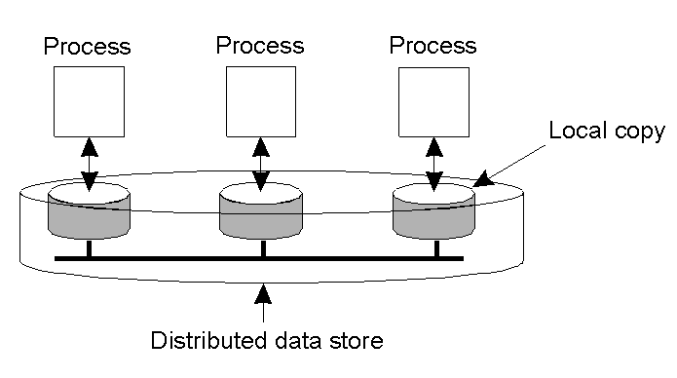
Data-Centric Consistency Models
A data-store can be read from or written to by any process in a distributed system.
A local copy of the data-store (replica) can support “fast reads”.
However, a write to a local replica needs to be propagated to all remote replicas.
Various consistency models help to understand the various mechanisms used to achieve and enable this.

Slide 32
What is a Consistency Model?
A “consistency model” is a CONTRACT between a DS data-store and its processes.
If the processes agree to the rules, the data-store will perform properly and as advertised.
We start with Strict Consistency, which is defined as:
Any read on a data item ‘x’ returns a value corresponding to the result of the most recent write on ‘x’ (regardless of where the write occurred).

Slide 33
Consistency Model Diagram Notation
W_{i}(x)a – a write by process ‘i’ to item ‘x’ with a value of ‘a’. That is, ‘x’ is set to ‘a’.
(Note: The process is often shown as ‘P_{i}’).
R_{i}(x)b – a read by process ‘i’ from item ‘x’ producing the value ‘b’. That is, reading ‘x’ returns ‘b’.
Time moves from left to right in all diagrams.

Slide 34

Strict Consistency Diagrams
Behavior of two processes, operating on the same data item:
A strictly consistent data-store.
A data-store that is not strictly consistent.
With Strict Consistency, all writes are instantaneously visible to all processes and absolute global time order is maintained throughout the DS. It is not at all easy in the real world, and all but impossible within a DS.
So, other, less strict (or “weaker”) models have been developed …

Slide 35
Sequential Consistency
A weaker consistency model, which represents a relaxation of the rules.
It is also easier to implement.
Definition of “Sequential Consistency”:
The result of any execution is the same as if the (read and write) operations by all processes on the data-store were executed in the same sequential order and the operations of each individual process appear in this sequence in the order specified by its program.

Slide 36

Sequential Consistency Diagrams
In other words: all processes see the same interleaving set of operations, regardless of what that interleaving is.
A sequentially consistent data-store – the “first” write occurred after the “second” on all replicas.
A data-store that is not sequentially consistent – it appears the writes have occurred in a non-sequential order, and this is NOT allowed.

Slide 37
Problem with Sequential Consistency
With this consistency model, adjusting the protocol to favour reads over writes (or vice-versa) can have a devastating impact on performance
For this reason, other weaker consistency models have been proposed and developed.
Again, a relaxation of the rules allows for these weaker models to make sense.

Slide 38
Linearizability and Sequential Consistency (1)
Process P1 | Process P2 | Process P3
x = 1; print ( y, z); | y = 1; print (x, z); | z = 1; print (x, y);
Three concurrently executing processes.

Slide 39
Linearizability and Sequential Consistency (2)
Four valid execution sequences for the processes of the previous slide. The vertical axis is time.
x = 1; print ((y, z); y = 1; print (x, z); z = 1; print (x, y); Prints: 001011 Signature: 001011 (a) | x = 1; y = 1; print (x,z); print(y, z); z = 1; print (x, y); Prints: 101011 Signature: 101011 (b) | y = 1; z = 1; print (x, y); print (x, z); x = 1; print (y, z); Prints: 010111 Signature: 110101 (c) | y = 1; x = 1; z = 1; print (x, z); print (y, z); print (x, y); Prints: 111111 Signature: 111111 (d)
But, for instance, 001001 is not allowed.

Slide 40
Causal Consistency
This model distinguishes between events that are “causally related” and those that are not.
If event B is caused or influenced by an earlier event A, then causal consistency requires that every other process see event A, then event B.
Operations that are not causally related are said to be concurrent.

Slide 41

More on Causal Consistency
A causally consistent data-store obeys this condition:
Writes that are potentially causally related must be seen by all processes in the same order. Concurrent writes may be seen in a different order on different machines (i.e., by different processes).
This sequence is allowed with a causally-consistent store, but not with sequentially or strictly consistent store. Note: it is assumed that W₂(x)b and W₁(x)c are concurrent.

Slide 42
FIFO Consistency
Defined as follows:
Writes done by a single process are seen by all other processes in the order in which they were issued, but writes from different processes may be seen in a different order by different processes.
This is also called “PRAM Consistency” – Pipelined RAM.
The attractive characteristic of FIFO is that it is easy to implement. There are no guarantees about the order in which different processes see writes – except that two or more writes from a single process must be seen in order.

Slide 43
Introducing Weak Consistency
Not all applications need to see all writes, let alone seeing them in the same order.
This leads to “Weak Consistency” (which is primarily designed to work with distributed critical regions).
This model introduces the notion of a “synchronization variable”, which is used update all copies of the data-store.

Slide 44
Weak Consistency Properties
The three properties of Weak Consistency:
Accesses to synchronization variables associated with a data-store are sequentially consistent.
No operation on a synchronization variable is allowed to be performed until all previous writes have been completed everywhere.
No read or write operation on data items are allowed to be performed until all previous operations to synchronization variables have been performed.

Slide 45
Weak Consistency: What It Means
So …
By doing a sync., a process can force the just written value out to all the other replicas.
Also, by doing a sync., a process can be sure it’s getting the most recently written value before it reads.
In essence, the weak consistency models enforce consistency on a group of operations, as opposed to individual reads and writes (as is the case with strict, sequential, causal and FIFO consistency).

Slide 46
Introducing Release Consistency
Question: how does a weakly consistent data-store know that the sync is the result of a read or a write?
Answer: It doesn’t!
It is possible to implement efficiencies if the data-store is able to determine whether the sync is a read or write.
Two sync variables can be used, “acquire” and “release”, and their use leads to the “Release Consistency” model.

Slide 47
Release Consistency
Defined as follows:
When a process does an “acquire”, the data-store will ensure that all the local copies of the protected data are brought up to date to be consistent with the remote ones if needs be.
When a “release” is done, protected data that have been changed are propagated out to the local copies of the data-store.

Slide 48

Release Consistency Example
A valid event sequence for release consistency.
Process P3 has not performed an acquire, so there are no guarantees that the read of ‘x’ is consistent. The data-store is simply not obligated to provide the correct answer.
P2 does perform an acquire, so its read of ‘x’ is consistent.

Slide 49
Release Consistency Rules
A distributed data-store is “Release Consistent” if it obeys the following rules:
Before a read or write operation on shared data is performed, all previous acquires done by the process must have completed successfully.
Before a release is allowed to be performed, all previous reads and writes by the process must have completed.
Accesses to synchronization variables are FIFO consistent (sequential consistency is not required).

Slide 50
Introducing Entry Consistency
A different twist on things is “Entry Consistency”. Acquire and release are still used, and the data-store meets the following conditions:
An acquire access of a synchronization variable is not allowed to perform with respect to a process until all updates to the guarded shared data have been performed with respect to that process.
Before an exclusive mode access to a synchronization variable by a process is allowed to perform with respect to that process, no other process may hold the synchronization variable, not even in nonexclusive mode.
After an exclusive mode access to a synchronization variable has been performed, any other process's next nonexclusive mode access to that synchronization variable may not be performed until it has performed with respect to that variable's owner.

Slide 51

Entry Consistency: What It Means
So, at an acquire, all remote changes to guarded data must be brought up to date.
Before a write to a data item, a process must ensure that no other process is trying to write at the same time.
Locks associate with individual data items, as opposed to the entire data-store. Note: P2’s read on ‘y’ returns NIL as no locks have been requested.

Slide 52
Summary of Consistency Models
Consistency models that do not use synchronization operations.
Models that do use synchronization operations. (These require additional programming constructs, and allow programmers to treat the data-store as if it is sequentially consistent, when in fact it is not. They “should” also offer the best performance).
Consistency | Description
Strict | Absolute time ordering of all shared accesses matters.
Linearizability | All processes must see all shared accesses in the same order. Accesses are furthermore ordered according to a (nonunique) global timestamp.
Sequential | All processes see all shared accesses in the same order. Accesses are not ordered in time.
Causal | All processes see causally-related shared accesses in the same order.
FIFO | All processes see writes from each other in the order they were used. Writes from different processes may not always be seen in that order.
 | (a)
Consistency | Description
Weak | Shared data can be counted on to be consistent only after a synchronization is done.
Release | Shared data are made consistent when a critical region is exited.
Entry | Shared data pertaining to a critical region are made consistent when a critical region is entered.
 | (b)

Slide 53
Client-Centric Consistency Models
The previously studied consistency models concern themselves with maintaining a consistent (globally accessible) data-store in the presence of concurrent read/write operations.
Another class of distributed data-store is that which is characterized by the lack of simultaneous updates. Here, the emphasis is more on maintaining a consistent view of things for the individual client process that is currently operating on the data-store.

Slide 54
More Client-Centric Consistency
How fast should updates (writes) be made available to read-only processes?
Think of most database systems: mainly read.
Think of the DNS: write-write conflicts do no occur.
Think of WWW: as with DNS, except that heavy use of client-side caching is present: even the return of stale pages is acceptable to most users.
These systems all exhibit a high degree of acceptable inconsistency … with the replicas gradually become consistent over time.

Slide 55
Toward Eventual Consistency
The only requirement is that all replicas will eventually be the same.
All updates must be guaranteed to propagate to all replicas … eventually!
This works well if every client always updates the same replica.
Things are a little difficult if the clients are mobile.

Slide 56
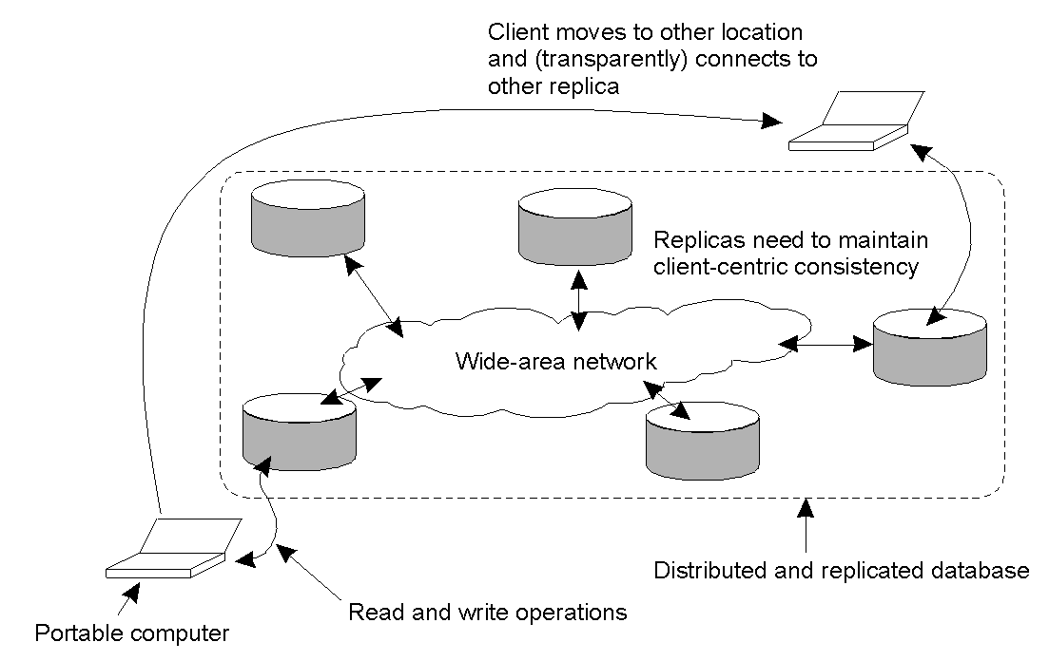
Eventual Consistency: Mobile Problems
The principle of a mobile user accessing different replicas of a distributed database.
When the system can guarantee that a single client sees accesses to the data-store in a consistent way, we then say that “client-centric consistency” holds.

Slide 57
An Example: The Bayou System
The Bayou System implements 4 models of Client-Centic Consistency:
Monotonic-Read Consistency- if a process reads the value of a data item ‘x’, any successive read operation on ‘x’ by that process will always return that same value or a more recent value
Monotonic-Write Consistency- A write operation by a process on a data item ‘x’ is completed before any successive write operation on ‘x’ by the same process.
Read-Your-Writes Consistency- The effect of a write operation by a process on data item ‘x’ will always be seen by a successive read operation on ‘x’ by the same process.
Writes-Follow-Reads Consistency-A write operation by a process on a data item ‘x’ following a previous read operation on ‘x’ by the same process, is guaranteed to take place on the same or a more recent value of ‘x’ that was read.

Slide 58
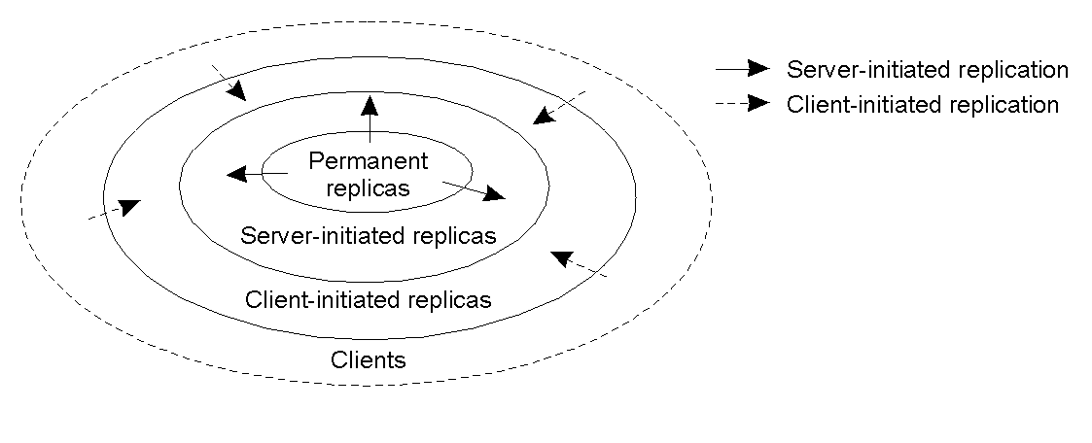
Distribution Protocols
Regardless of which consistency model is chosen, we need to decide where, when and by whom copies of the data-store are to be placed.

Slide 59
Replica Placement Types
There are three types of replica:
Permanent replicas: tend to be small in number, organized as COWs (Clusters of Workstations) or mirrored systems.
Server-initiated replicas: used to enhance performance at the initiation of the owner of the data-store. Typically used by web hosting companies to geographically locate replicas close to where they are needed most. (Often referred to as “push caches”).
Client-initiated replicas: created as a result of client requests – think of browser caches. Works well assuming, of course, that the cached data does not go stale too soon.

Slide 60
Update Propagation
When a client initiates an update to a distributed data-store, what gets propagated?
There are three possibilities:
Propagate notification of the update to the other replicas – this is an “invalidation protocol” which indicates that the replica’s data is no longer up-to-date. Can work well when there’s many writes.
Transfer the data from one replica to another – works well when there’s many reads.
Propagate the update to the other replicas – this is “active replication”, and shifts the workload to each of the replicas upon an “initial write”.

Slide 61
Push vs. Pull Protocols
Another design issue relates to whether or not the updates are pushed or pulled?
Push-based/Server-based Approach: sent “automatically” by server, the client does not request the update. This approach is useful when a high degree of consistency is needed. Often used between permanent and server-initiated replicas.
Pull-based/Client-based Approach: used by client caches (e.g., browsers), updates are requested by the client from the server. No request, no update!

Slide 62
Push vs. Pull Protocols: Trade Offs
Issue | Push-based | Pull-based
State on server. | List of client replicas and caches. | None.
Messages sent. | Update (and possibly fetch update later). | Poll and update.
Response time at client. | Immediate (or fetch-update time). | Fetch-update time.
A comparison between push-based and pull-based protocols in the case of multiple client, single server systems.
Hybrid schemes are possible: e.g., “leases” – a promise from a server to push updates to a client for a period of time. Once the lease expires, the client reverts to a pull-based approach (until another lease is issued).

Slide 63
Epidemic Protocols
This is an interesting class of protocol that can be used to implement Eventual Consistency (note: these protocols are used in Bayou).
The main concern is the propagation of updates to all the replicas in as few a number of messages as possible.
Of course, here we are spreading updates, not diseases!
With this “update propagation model”, the idea is to “infect” as many replicas as quickly as possible.

Slide 64
Epidemic Protocols: Terminology
Server types:
Infective replica: a server that holds an update that can be spread to other replicas.
Susceptible replica: a yet to be updated server.
Removed replica: an updated server that will not (or cannot) spread the update to any other replicas.
The trick is to get all susceptible servers to either infective or removed states as quickly as possible without leaving any replicas out.

Slide 65
The Anti-Entropy Protocol
Entropy: “a measure of the degradation or disorganization of the universe”.
Server P picks Q at random and exchanges updates, using one of three approaches:
P only pushes to Q.
P only pulls from Q.
P and Q push and pull from each other.
Sooner or later, all the servers in the system will be infected (updated). Works well.

Slide 66
The Gossiping Protocol
This variant is referred to as “gossiping” or “rumor spreading”, as works as follows:
P has just been updated for item ‘x’.
It immediately pushes the update of ‘x’ to Q.
If Q already knows about ‘x’, P becomes disinterested in spreading any more updates (rumors) and is removed.
Otherwise P gossips to another server, as does Q.
This approach is good, but can be shown not to guarantee the propagation of all updates to all servers.

Slide 67
The Best of Both Worlds
A mix of anti-entropy and gossiping is regarded as the best approach to rapidly infecting systems with updates.
However, what about removing data?
Updates are easy, deletion is much, much harder!
Under certain circumstances, after a deletion, an “old” reference to the deleted item may appear at some replica and cause the deleted item to be reactivated!
One solution is to issue “Death Certificates” for data items – these are a special type of update.
Only problem remaining is the eventual removal of “old” death certificates (with which timeouts can help).

